Slide 1
Robotics
Made by: Balint Bekesi

Slide 2
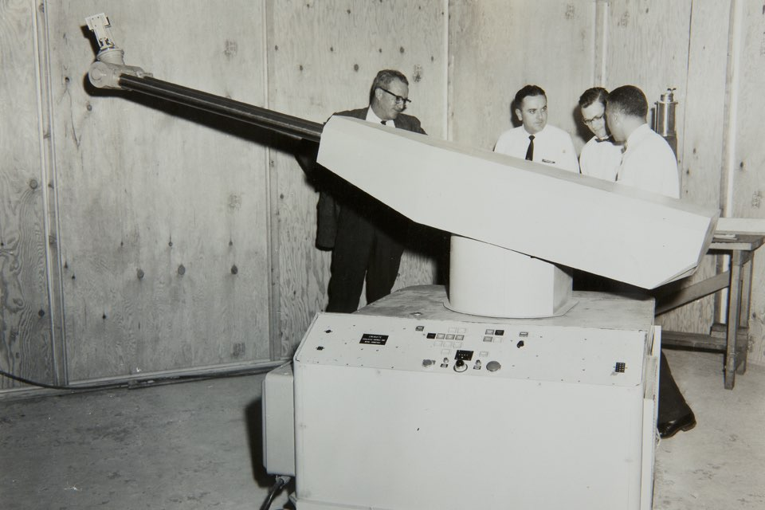
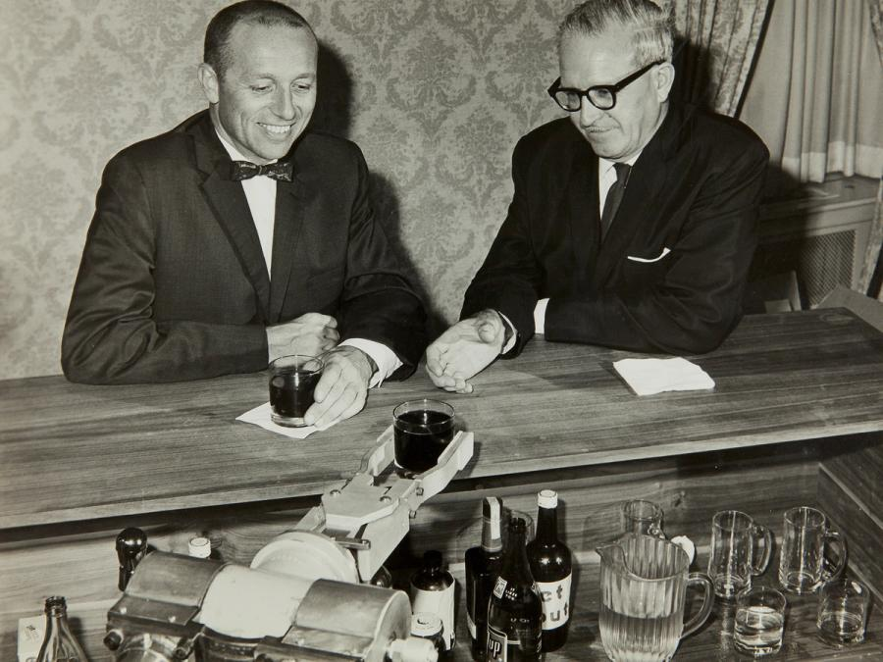
1.
How it started
Birth of a kawasaki industrial robot in the us (1954)
Unimation cofounders with their robot bartender (1958)

Slide 3
2.

Slide 4
3.

Slide 5
4.

